Slide 1
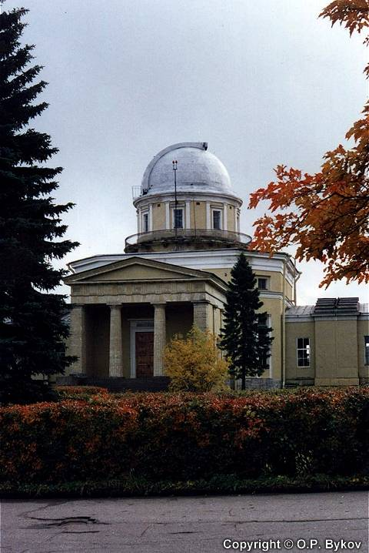
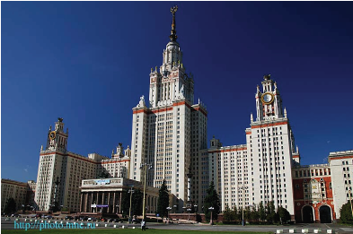
Latest ATLAS results
Lidia Smirnova
M.V.Lomonosov Moscow State University, Moscow
Workshop on Precision Physics and Fundamental Physics Constants (FFK 2013), Pulkovo, St-Petersburg, 7-11 October 2013

Slide 2
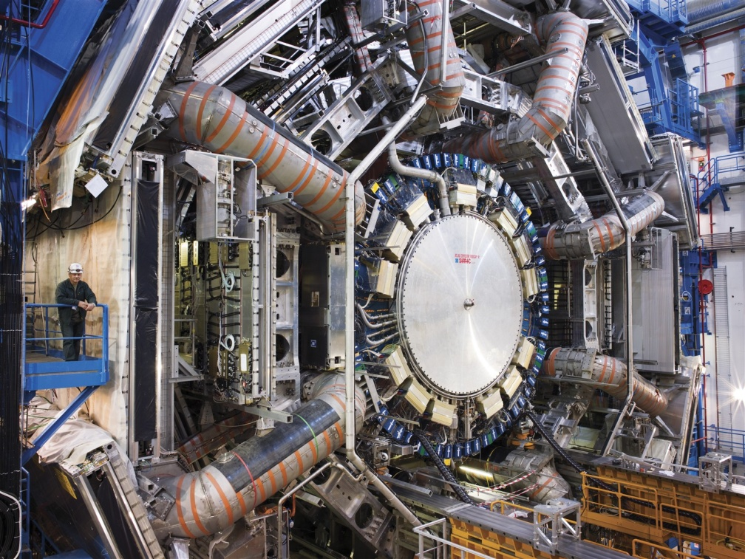
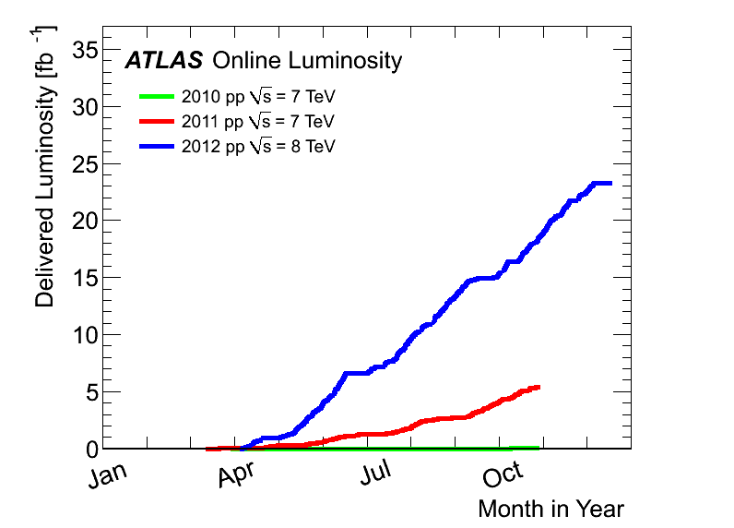
Outlines
Higgs Properties
Standard Model measurements
News for Top
B-physics
New highlights from SUSY and Exotics
More than 220 published papers with collisions data!
Higgs Discovery!
8TeV, 21.7fb-1
July 2012
7TeV, 5.2fb-1

Slide 3
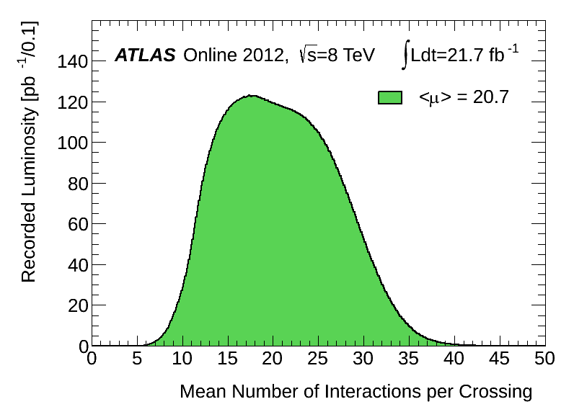
ATLAS detector
JINST 3 (2008) S08003
44 m
Muon Spectrometer
(lηl<2.7)
Calorimeters
(lηl<4.9)
25 m
Inner Detector
(lηl<2.5)
Peak luminosity 2012
L is up to 7.7∙10³³ cm⁻²s⁻¹ pile-up up to 40 events
Trigger
3 levels:
40 MHz→200Hz
μ=L_{bunch} x σ_{inel} / f_{r}
arXiv:1101.2185

Slide 4
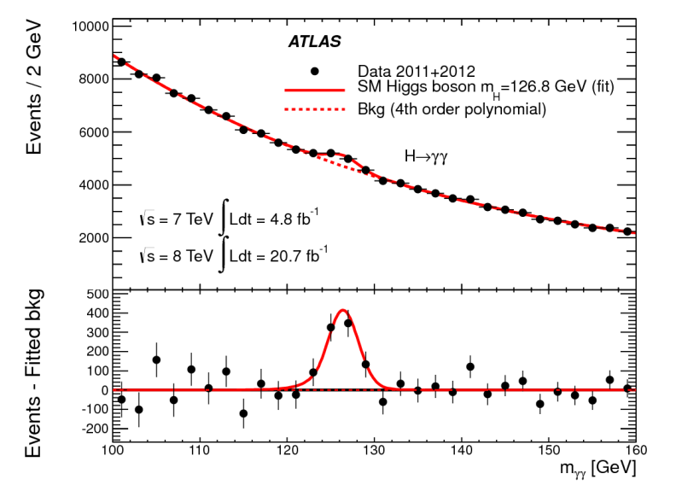
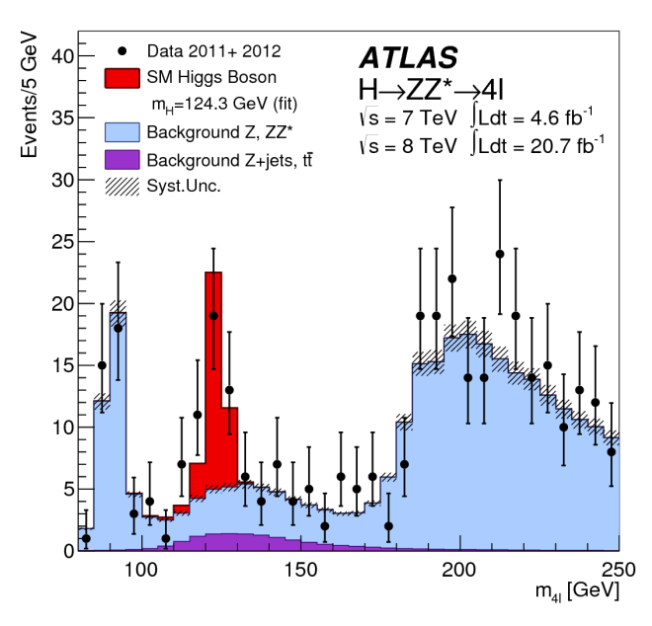
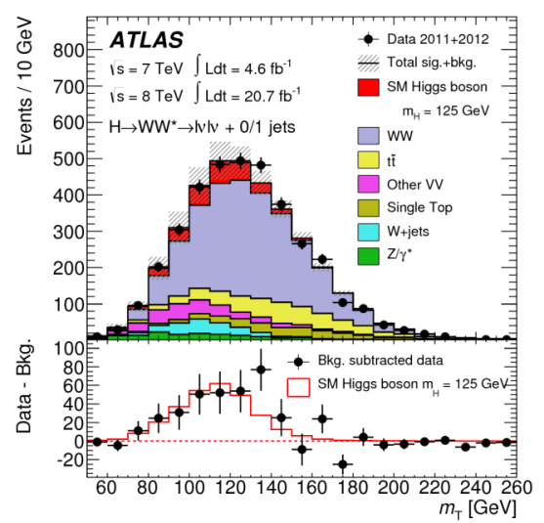
Higgs boson measurements
Observation of new particle…
Phys.Lett.B 716 (2012) 1-29
Result with 6 sigma signal!
Latest measurements of Higgs boson production and couplings in diboson final states
arXiv:1307.1427v1, 4 July 2013
With data sample ~2.5 times larger than before!
H→γγ
H→ZZ*→4l
H→WW*→lνlν+0/1jet

Slide 5
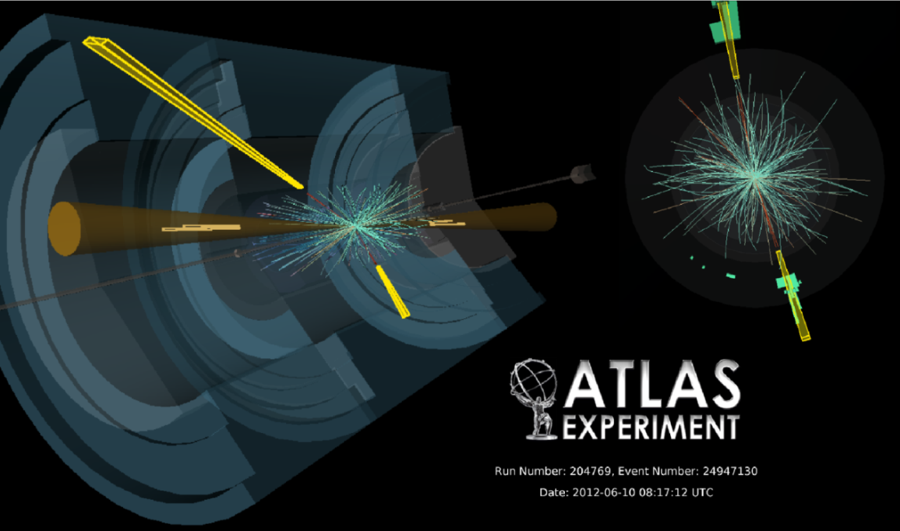
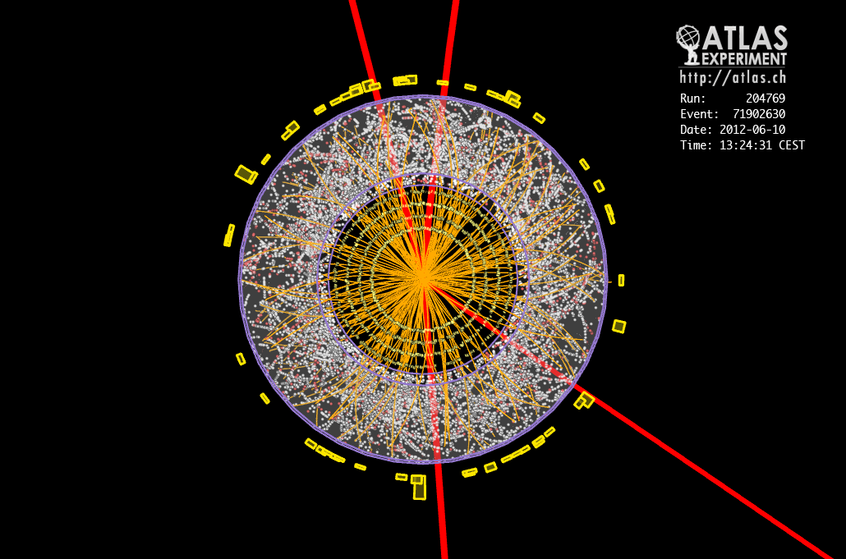
Higgs mass
H→γγ
H→γγ
m_{H} = 126.8 ± 0.2(stat) ±0.7(sys) GeV
H→ZZ* →ll
mH = 124.3 ± ^{0.60}_{0.5}(stat)±^{0.50}_{0.3}(sys) GeV
Combined mass from these channels
m_{H} = 125.5 ± 0.2(stat) ±^{0.50}_{0.3}(sys) GeV
H→µµµµ
Δm_{H} = 2.3 ±^{0.6}_{0.7}(stat) ± 0.6(sys) GeV
The consistency of this Δm_{H} with 0 is evaluated to be up to 2 %

Slide 6
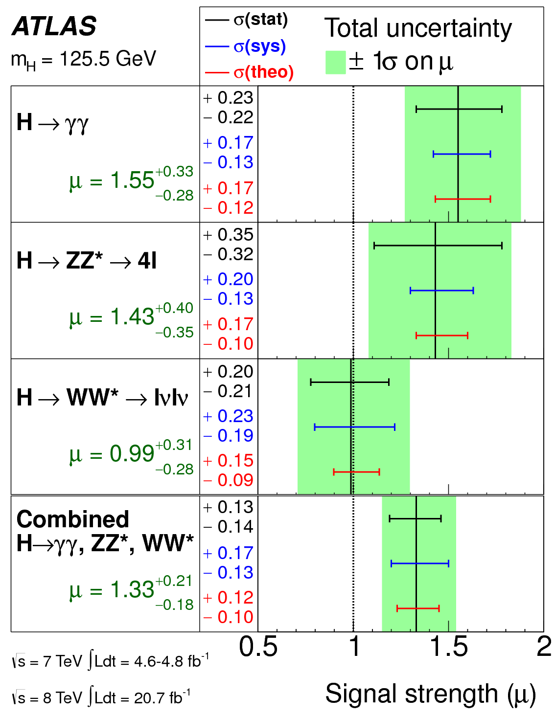
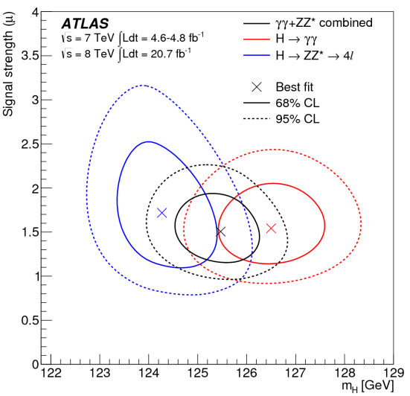
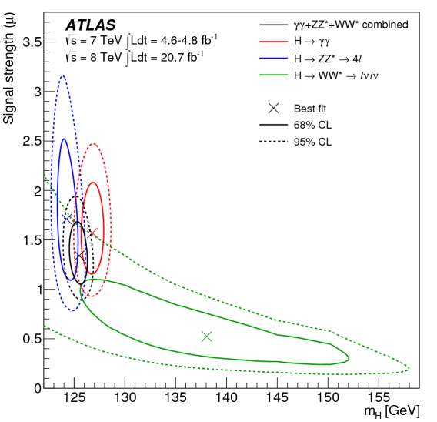
Higgs Signal Strength to SM: µ=σ^{obs}/σ_{SM}
Signal Strength vs Higgs mass
H→γγ, H→ZZ* + combined
H→γγ, H→ZZ* , H→WW*
The overall signal production strength
µ = 1.33 ± 0.14 (stat) ± 0.15 (syst)
Compatibility with SM (µ=1): 7%
Largest deviation in µ_{γγ} : 1.9σ

Slide 7
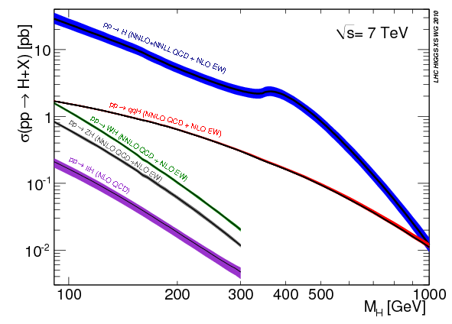
Higgs production mechanisms in SM
ggF
Higgs strahlung VH + tt̃H
With additional data event categories targeting specific production modes were introduced, providing enhanced sensitivity to different Higgs boson couplings.
ggF | VBF | WH | ZH | tt̃H | Total
19.52 | 1.58 | 0.70 | 0.39 | 0.13 | 22.32
Cross sections (pb) at 8 TeV
(m_{H} = 125 GeV)

Slide 8
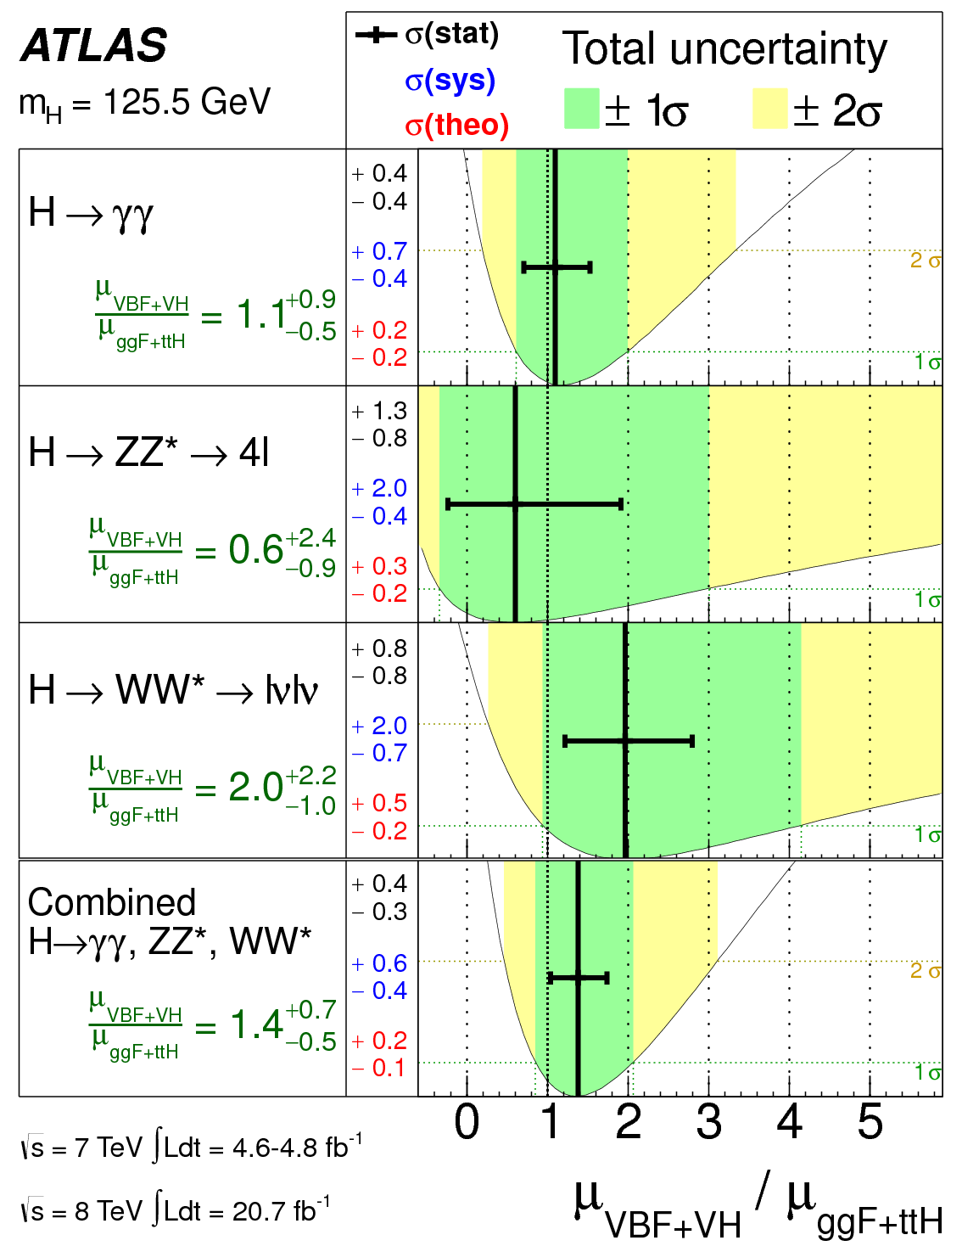
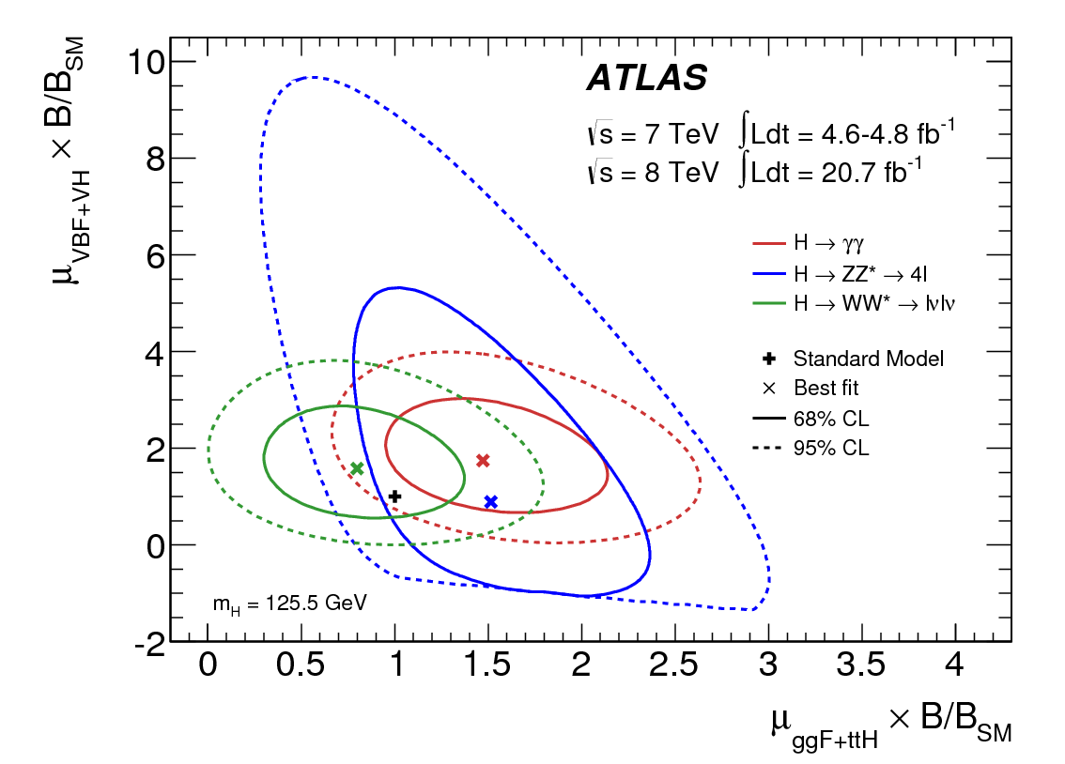
Evidence for production via vector-boson fusion
The ratio μ_{VBF+VH} / μ _{ggF+ttH}
was fitted for the individual channels (model independently) and combined value is found:
.
Evidence for VBF is at 3.3σ level.
Good agreement with SM expectations is observed.

Slide 9
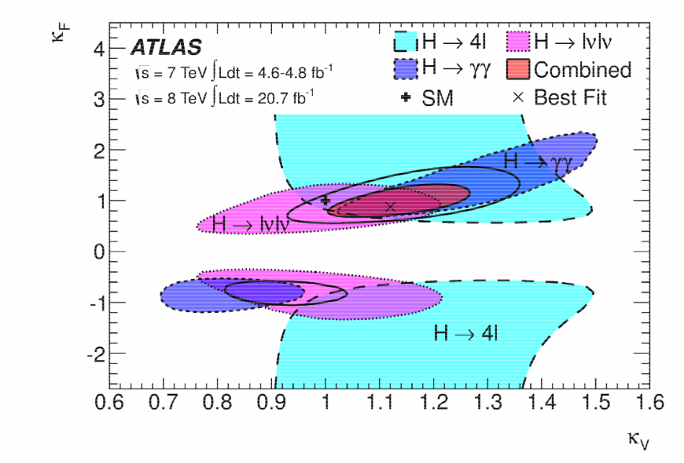
Coupling measurements: coupling to fermions and bosons
Assumptions:
Single resonance with m = 125.5 GeV
It is narrow, allowing zero-width approximation σ∙B(i→H→f)=σ_{i}∙ Г_{f}/ Г_{H}
Tensor structure of Lagrangian corresponds to SM, the resonance is CP-even scalar; k_{j} is coupling scale factor for j particle compared to SM (with k_{j}²). No BSM contributions.
Assume
k_{V} = k_{W} = k_{Z}; k_{F} = k_{b} = k_{t} =k_{tau}
and k_{V} > 0; Obtain
The two-dimension consistency with SM is 12% (~2σ level)
With 68% CL
k_{F} = [0.76, 1.18] k_{V}= [1.05, 1.22]

Slide 10
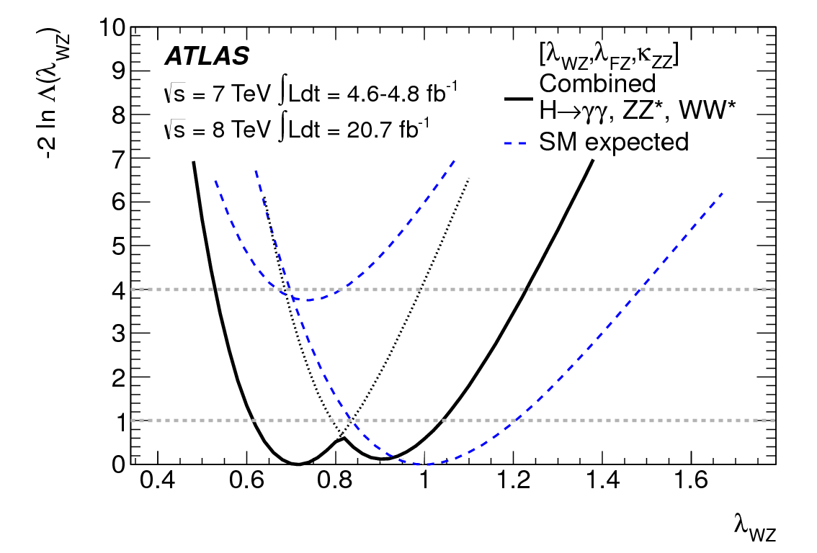
Ratio of couplings to the W and Z bosons
The identity of coupling to Higgs for W and Z was tested by extracting the ratio λ_{WZ} = k_{W}/k_{Z}
from inclusive H→WW* and H→ZZ* rates ;
λ_{WZ} = 0.81^{+0.16}_{-0.15} was found.
More sensitive analysis includes WH and ZH production and is shown on figure.
The extended fit for λ_{WZ} with absorption possible BSM effects shows λ_{WZ} = 0.82 ± 0.15
( with the 4D compatibility to SM predictions 20%)

Slide 11
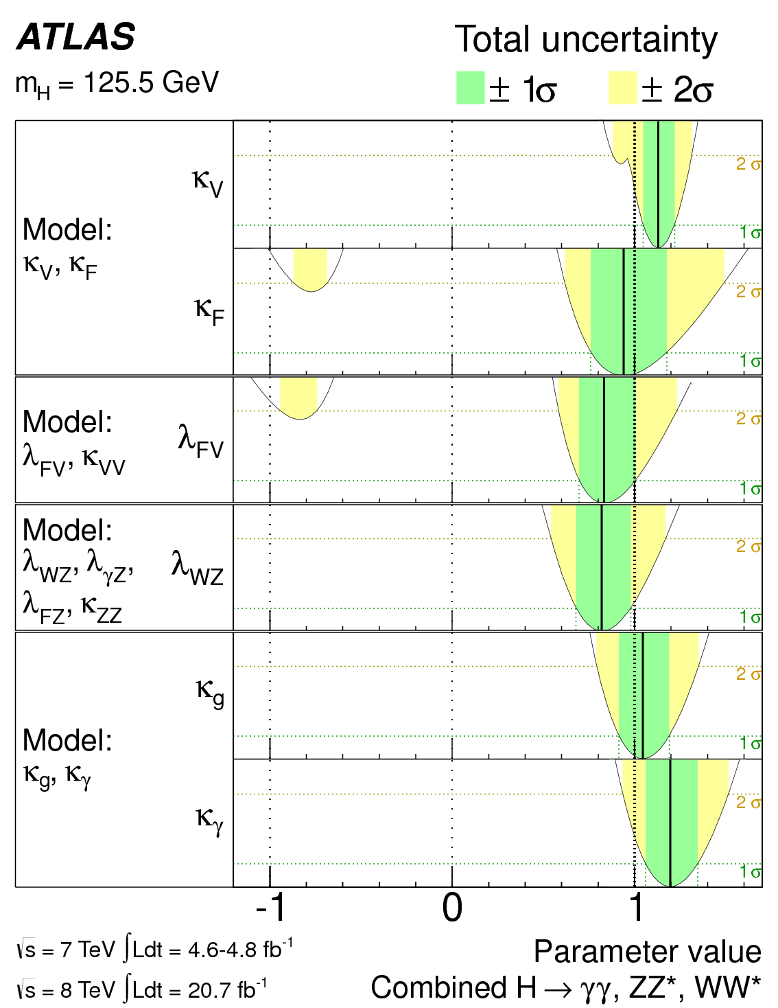
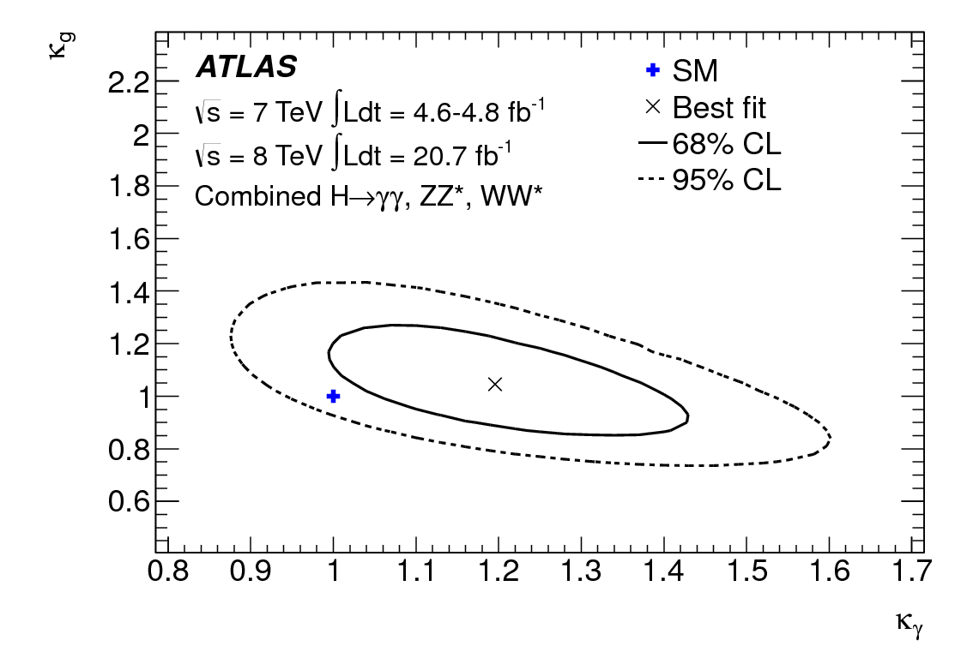
Constraints on production and decay loops
Summary of measurements of the coupling scale factors for a Higgs boson m_{H}=125.5 GeV
Scenarios of possible contribution of BSM particles to loop-induced processes in gg→H production and H→γγ decay;
k_{g} and k_{γ} parameterise these effects
k_{g} = 1.04 ± 0.14
k_{γ} = 1.20 ± 0.15

Slide 12
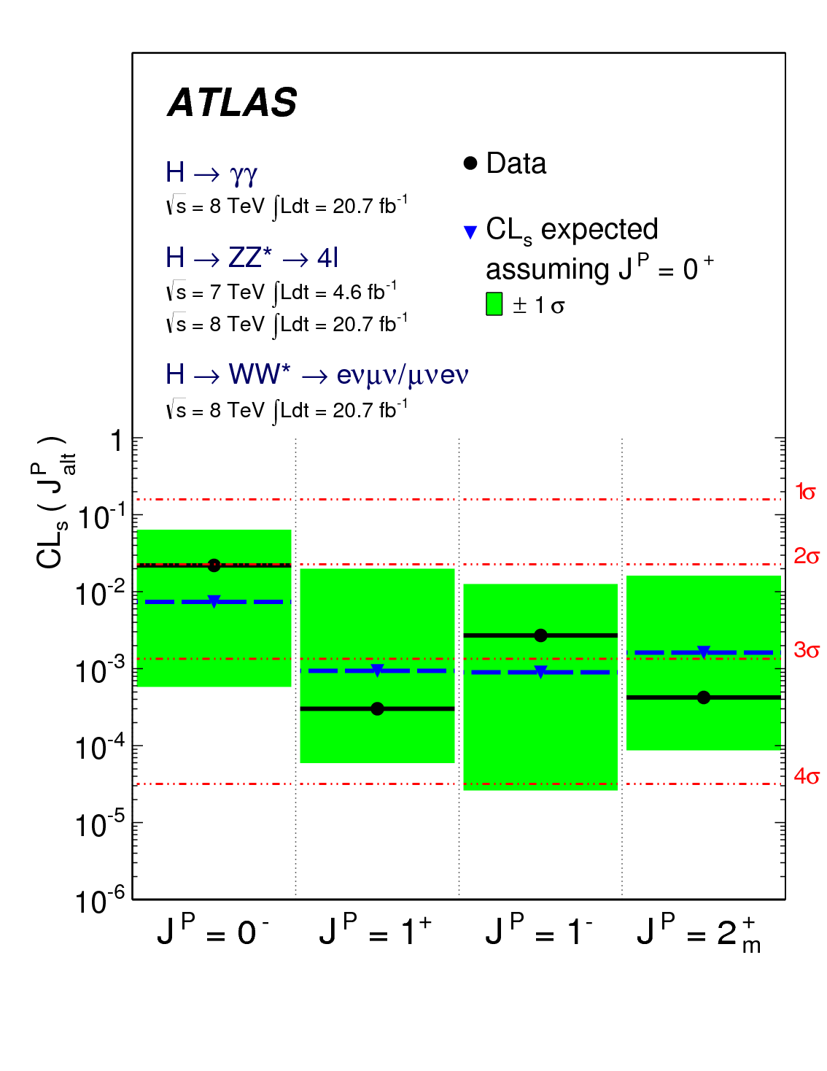
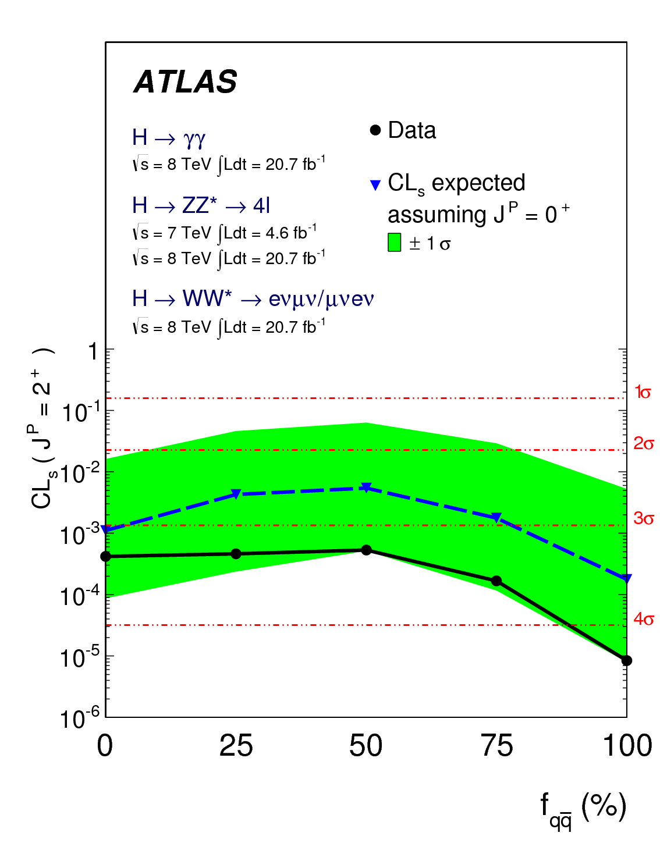
Combined spin analysis (arXiv:1307.1432)
H→γγ, H→ZZ→4l, H→WW→lνlν
and combined
Standard Model Higgs boson J^{P}= 0⁺ compared with alternative 0⁻, 1⁻,1⁺, 2⁺ hypotheses; they are excluded at CL more than 97.8%
Combined CL_{s} J^{P} =2⁺ _{m} exclusion is observed
at 3-4σ level
the fractions of quark-antiquark production of the spin-2 particle
H→γγ
H→γγ
Combined exclusion generally at 2-3σ level
H→WW
Largest contributions

Slide 13
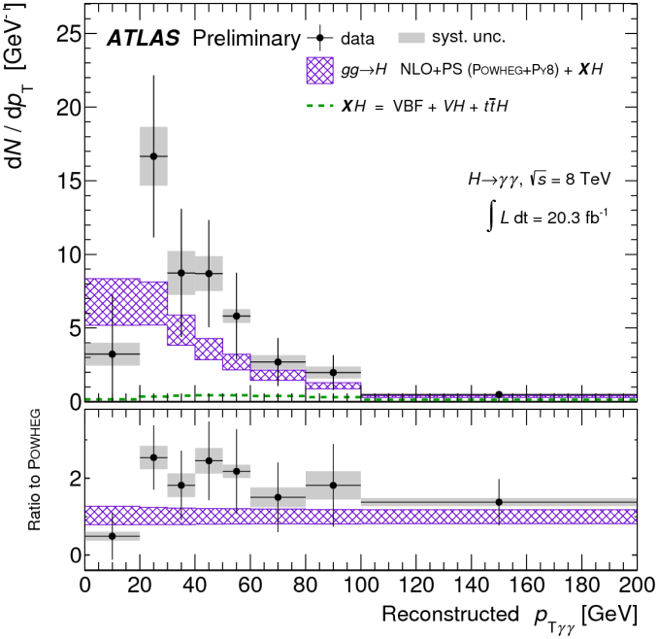
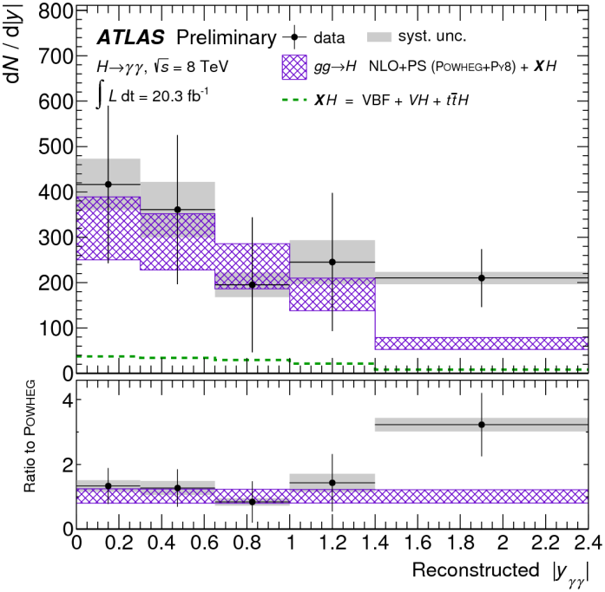
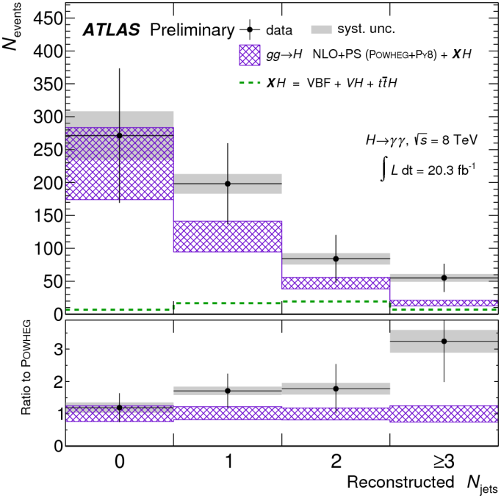
Differential Higgs boson spectra in H→γγ decay mode with 20.3 fb⁻¹
m_{H} = 126.8 GeV
Fiducial signal MC Incl. | Fully Simulated and Selected Signal [%] At √s=8TeV and m_{H} = 125 GeV
Yield | ggH | VBF | WH | ZH | tt̃H
407 | 87.9 | 7.3 | 2.8 | 1.6 | 0.5
Within uncertainties no significant deviation from the SM expectation is observed
ATLAS-CONF-2013-072, 18 July 2013

Slide 14
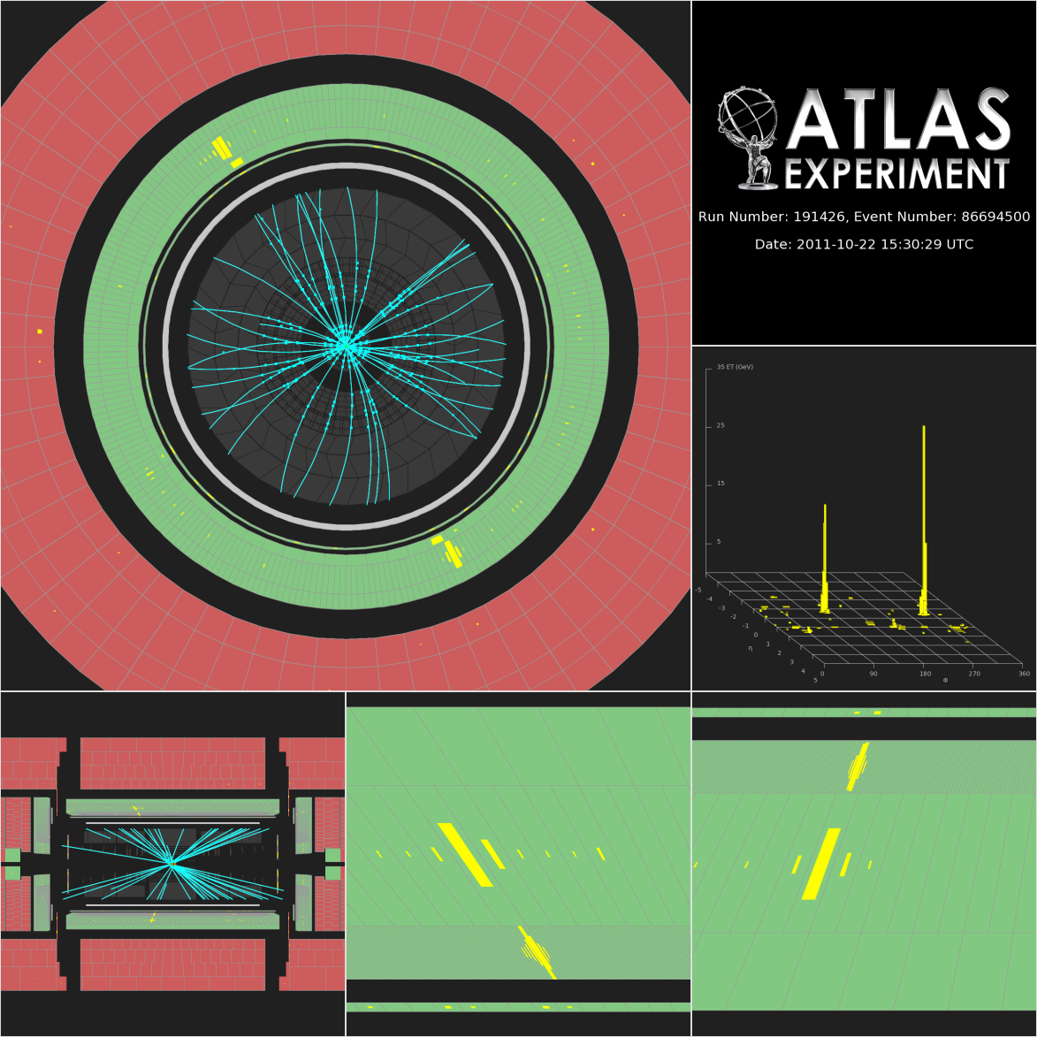
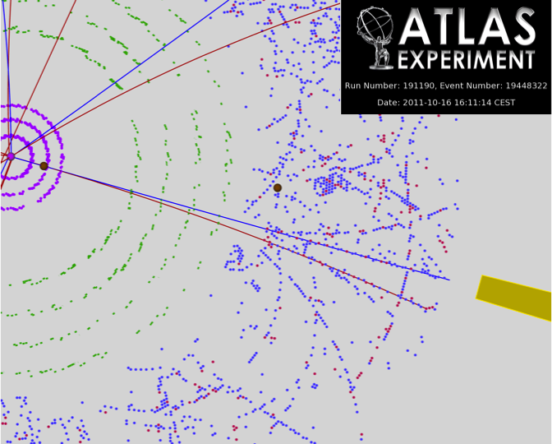
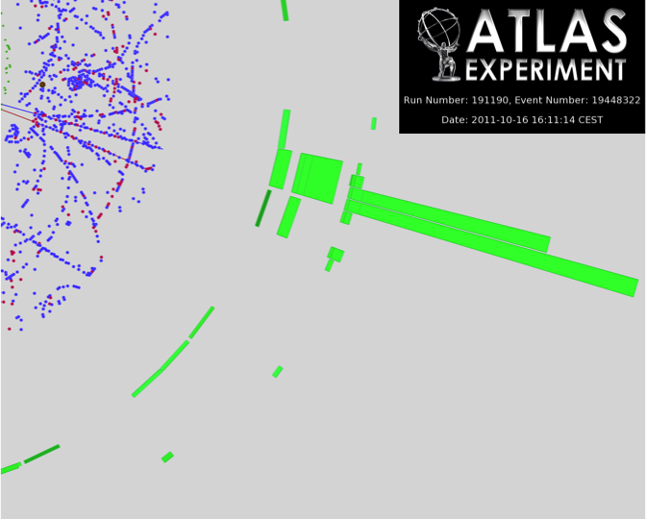
H→γγ candidate events without (left) and with photon conversion
ATLAS-CONF-2011-161

Slide 15
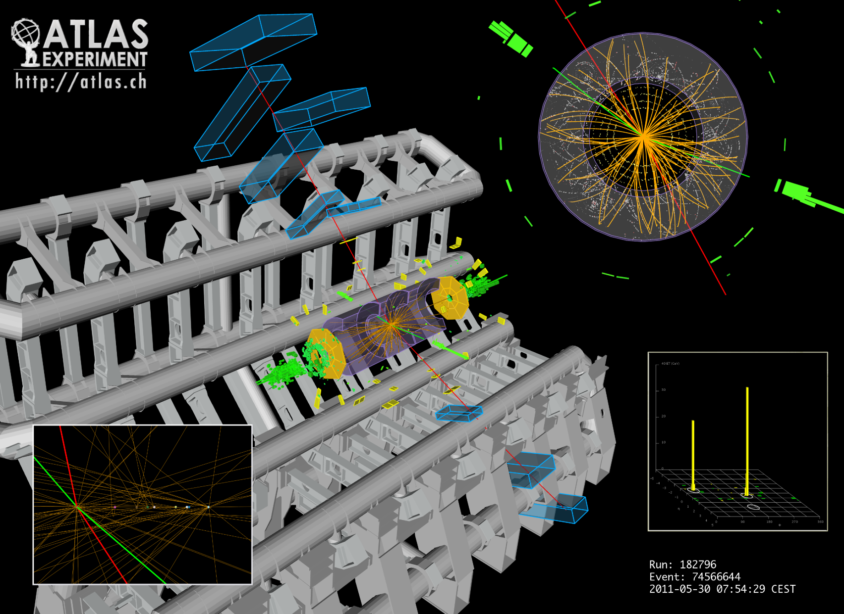
H→ZZ^{(*)}→ 2e2μ candidate event with m_{4l}=124.3 GeV. The masses of the lepton pairs are 76.8 and 45.7 GeV (ATLAS-CONF-2011-162).

Slide 16
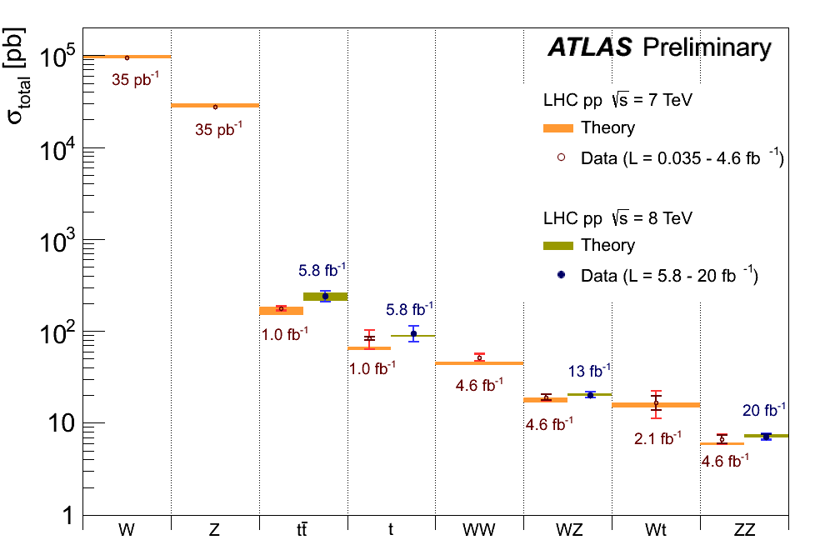
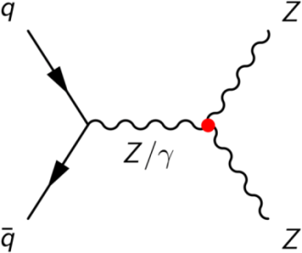
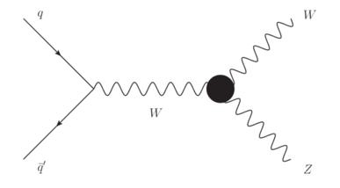
Standard Model measurements: Dibosons
Main background
for Higgs boson
measurements
Estimation for aTGC
Standard Model validation for processes
with smaller cross sections
Impressive agreement with theory across orders of magnitudes

Slide 17
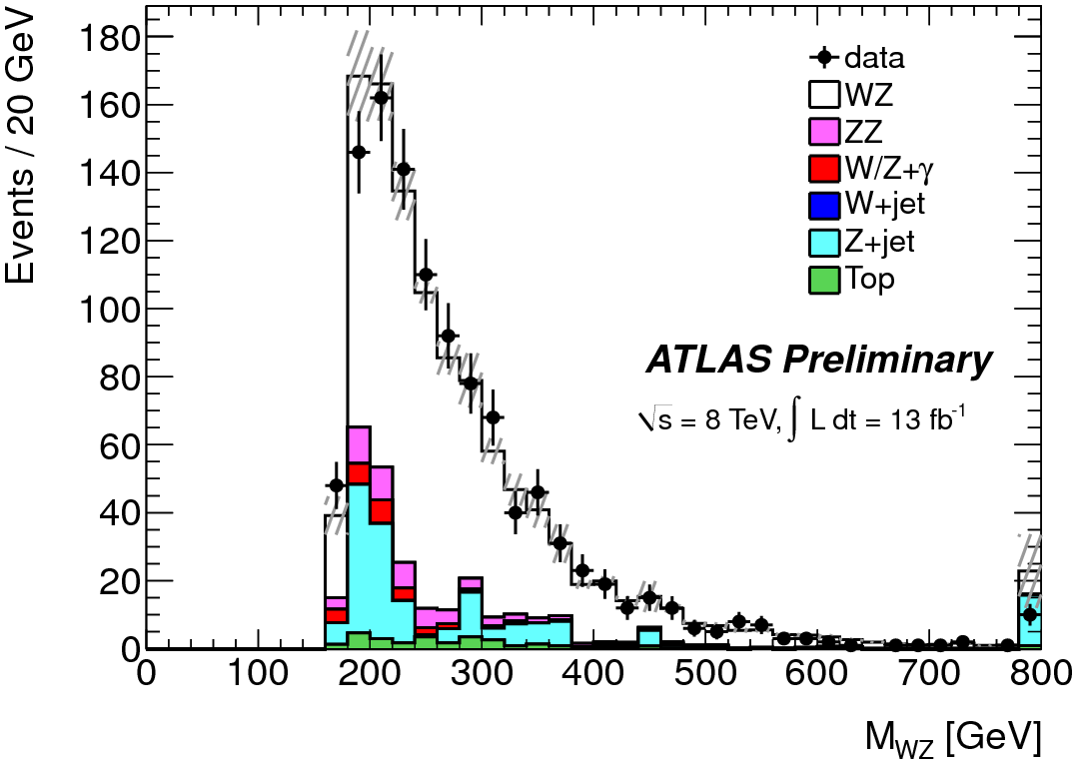
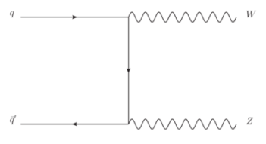
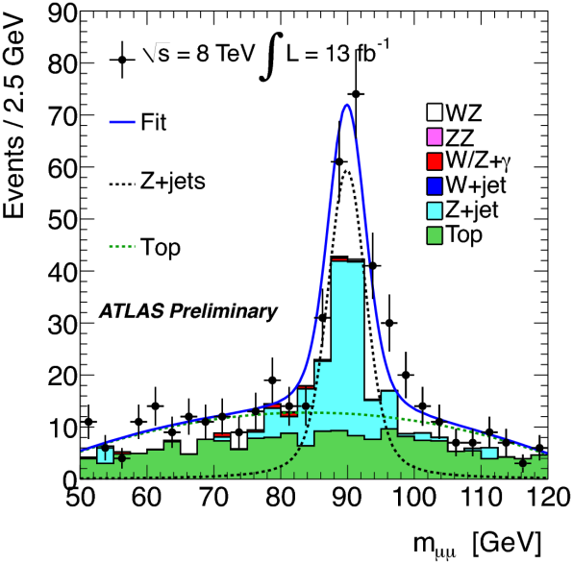
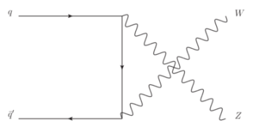
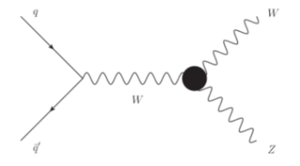
WZ production
With 13 fb-1 at 8 TeV 1094 candidates W±Z and 277±9±24 bkg are observed in µµµ, eµµ, eeµ and eee modes
Tree-level diagrams and WWZ aTGC
σ _{tot} (WZ) =20.3 ^{+0.8} _{−0.7} (stat) ^{+1.2} _{−1.1} (syst.) ^{+0.7} _{−0.6} (lumi.) pb,
in agreement with the Standard Model expectation of 20.3 pb.
ATLAS-CONF-2013-021

Slide 18
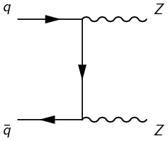
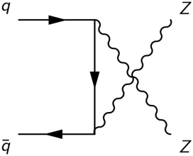
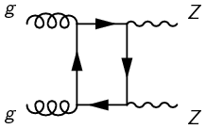
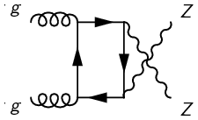
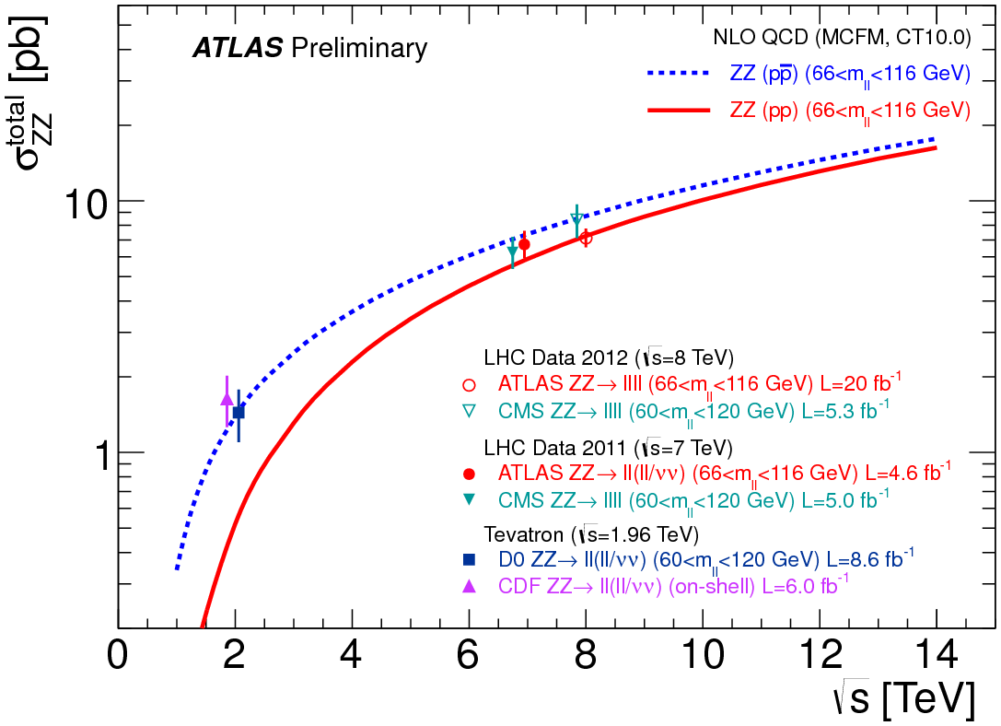
ZZ production
Latest ZZ production cross section measurement at √s = 8 TeV with data of 20 fb⁻¹ ( ATLAS-CONF-2013-020)
Leading order diagrams for ZZ production in SM
at hadron colliders
σ_{zz} is a test of EW sector of Standard Model
Deviations from SM could indicate contribution of new resonances decaying to Z or other non-SM processes
Result σ_{zz}= 7.1±0.5(stat)±0.3(syst)±0.2(lumi)pb consistent with SM expectation of 7.2±0.3pb

Slide 19
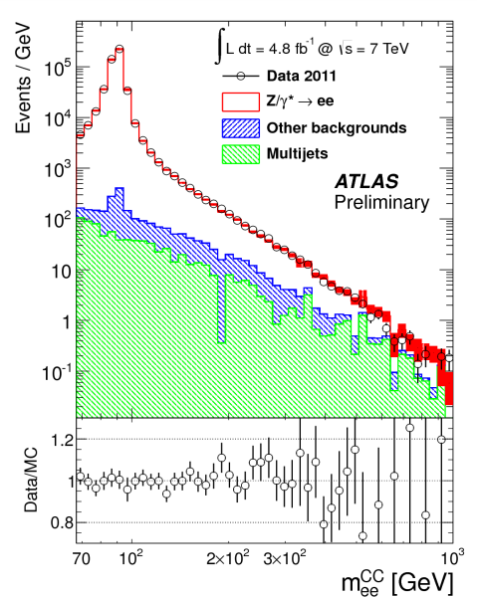
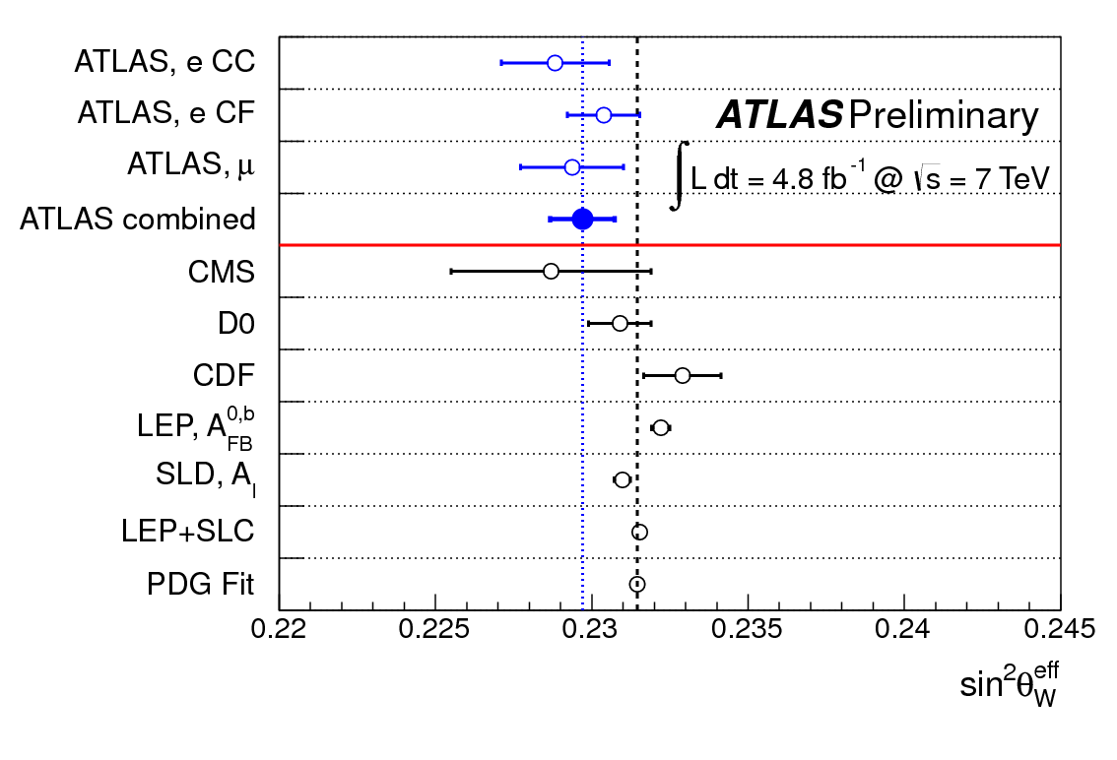
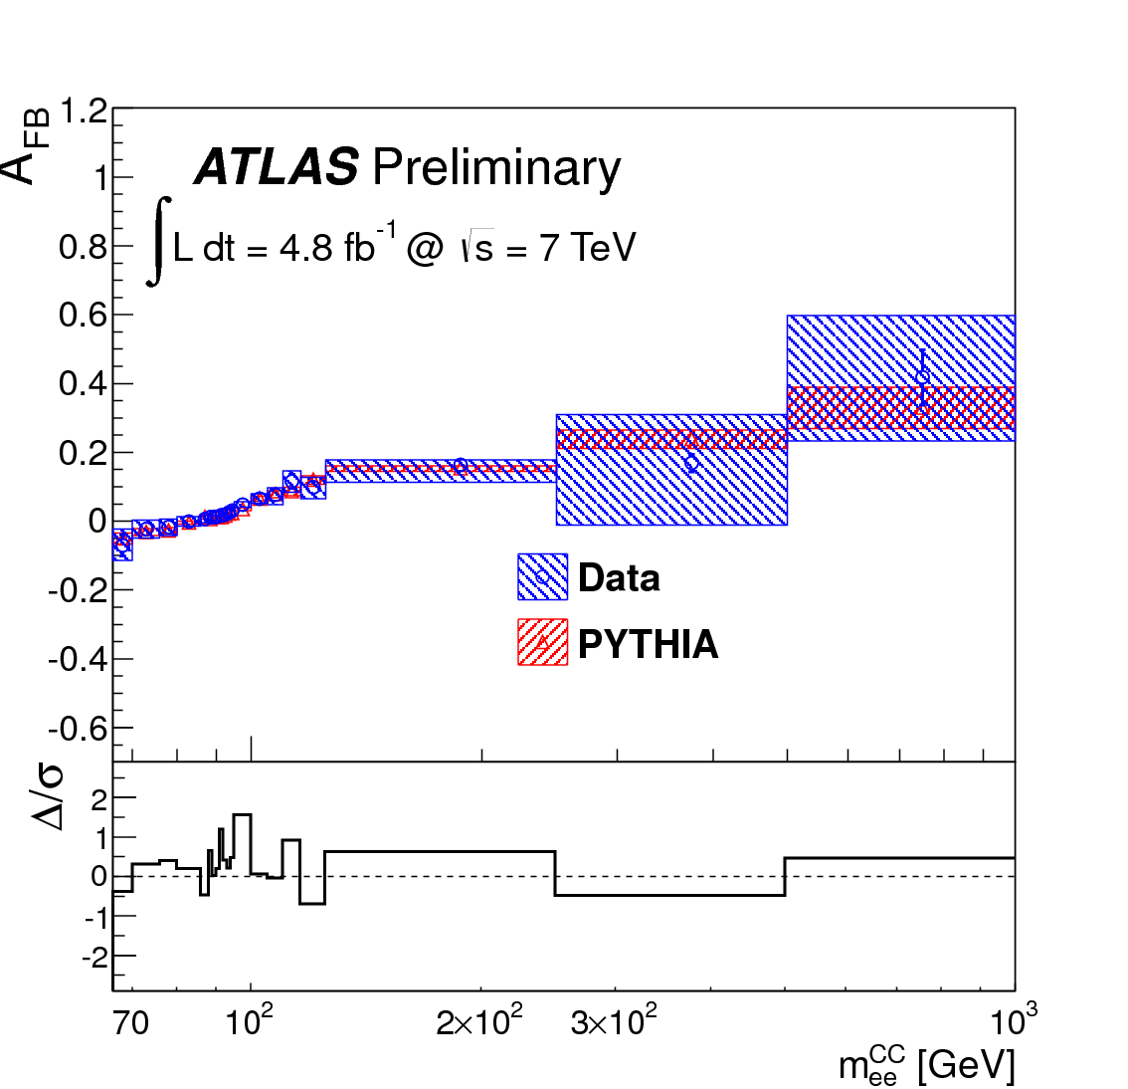
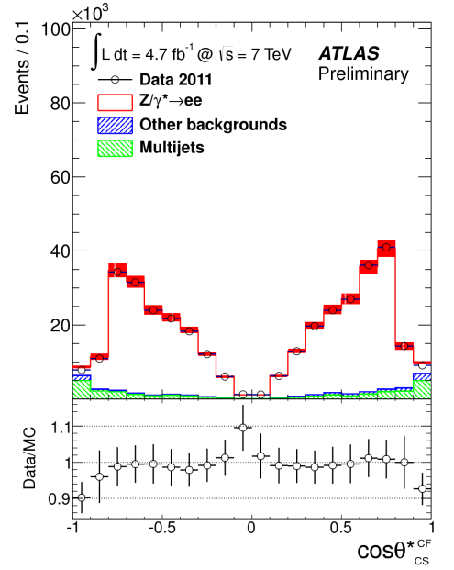
Forward-backward asymmetry in Z/γ* production at pp √s=7 TeV (4.8 fb⁻¹)
ATLAS
qq̃→Z/γ*→l+l-
Cosθ* _{CS} >0 F
Cosθ* _{CS} <0 B
A_{FB}
PDG fit
sin²θ_{W}^{eff}=0.2297±0.0004(stat.)
±0.0009(syst.)
First result from combined electron and muon measurements at Z pole,
as precise as D0 result
ATLAS-CONF-2013-043

Slide 20
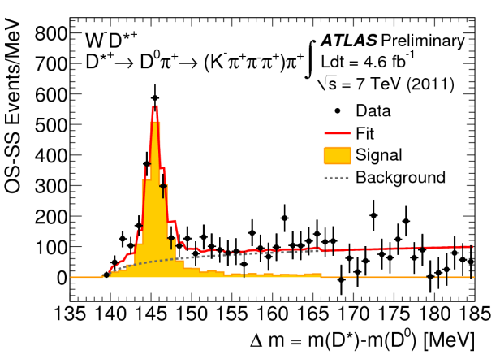
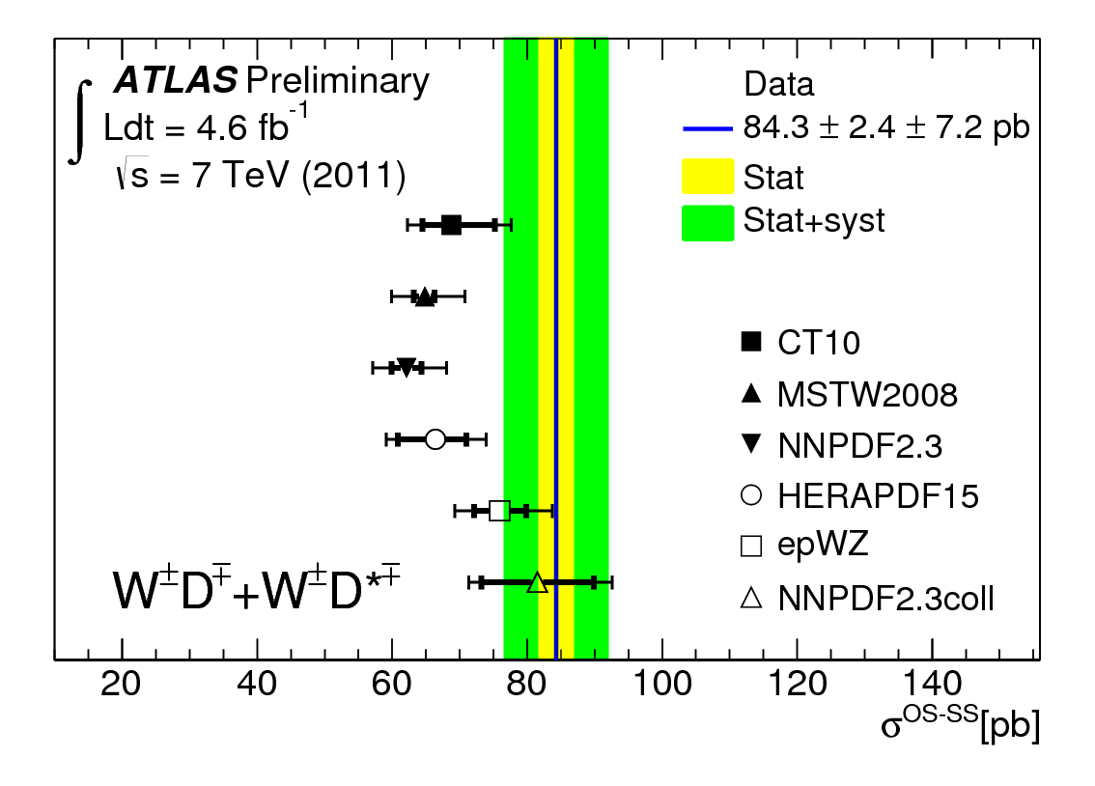
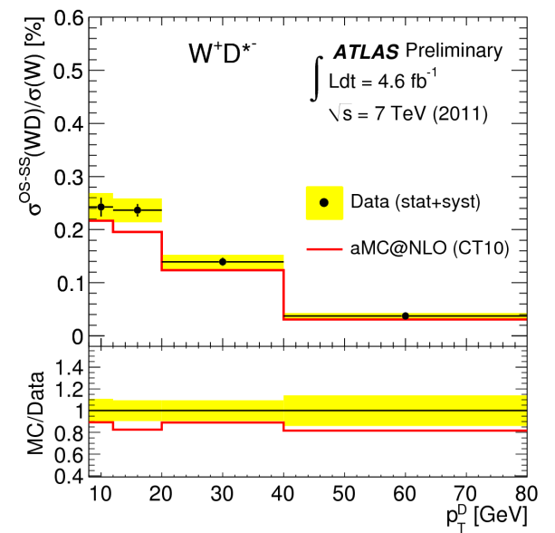
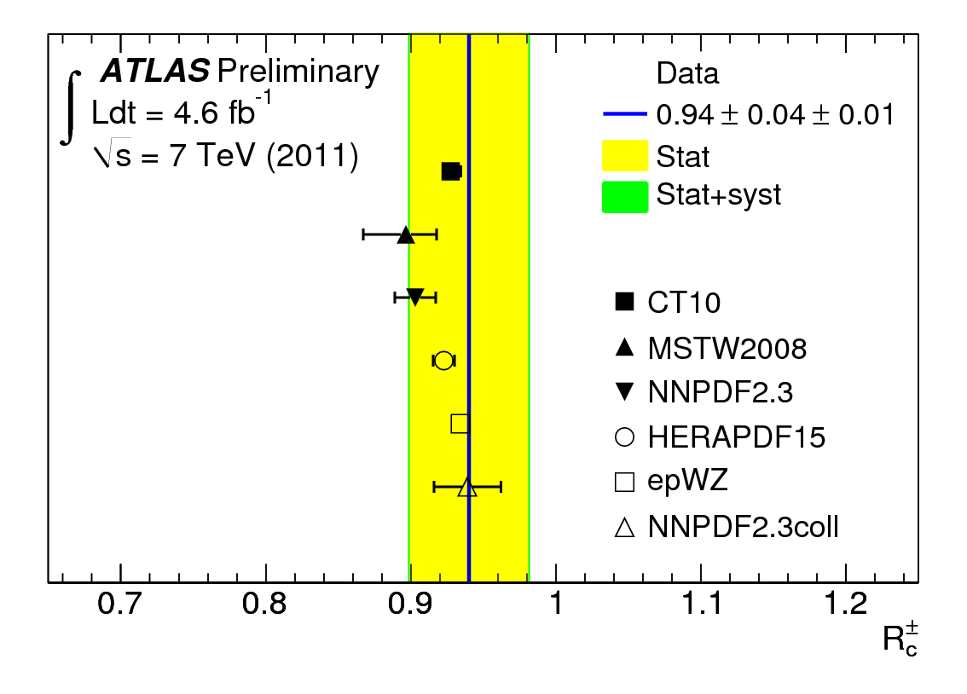
W+charm hadron production at 7 TeV The goal – to constrain s-quark PDF at Q² ~ m²_{W}
Sum of measured cross sections σ(D*) + σ(D±) compared to different PDF predictions based on aMC@NLO.
PDFs with comparable s and d sea at x~0.01 are preferable
Same for asymmetry ratios R_{C}±= 0.94±0.04±0.01
R_{C}± is consistent with all PDFs studied
σ(WD) /σ(W)% vs p_{T}^{D}
ATLAS-CONF-2013-045

Slide 21
Measurement of the high-mass Drell-Yan differential cross-section
pp at 7 TeV 4.9 fb⁻¹
116 < m_{ee}< 1500 GeV and │η│<2.5
Electron p_{T}>25 GeV
PYTHIA,MC@NLO and SHERPA predictions consistent with the shape of measured m_{ee} distribution. Data have potential to constrain PDFs, particular for antiquarks at large x.
arXiv:1305.4192

Slide 22
Mulijet cross section rations and strong coupling constant
Measured in pp at √s = 7 TeV
α_{s}(M_{Z})=0.111±0.006(exp^{)+0.016} _{-0.003}(theory)
is in statistical agreement with accepted world average and D0 and CDF results
R _{3/2}
vs P_{T}^{lead}
N _{3/2}
vs P_{t}^{lall jets}
ATLAS-CONF-2013-041

Slide 23
Inclusive cross section for isolated prompt photons in pp at 7 TeV
Sensitive to gluon contend in proton through qg → qγ
Measured up to TeV region!
NLO calculations agree with data up to highest E_{t}^{γ}.
Total inclusive cross section for E_{T}>100GeV, │η│<1.37 and E^{iso}<7GeV
σ(γ+X) = 234±2(stat)⁺¹³₋₉ (syst) ±4(lumi)pb
Compared with predictions of PYTHIA 224pb, HERWIG 187pb, NLO (CT10) 203±25pb
Isolated photons with E^{iso}<7GeV at ΔR<0.4
Prompt isolated photon dσ/dE_{T} for │η│<1.37(“direct” and “fragmentation” photons)
ATLAS-CONF-2013-022

Slide 24
Top production cross sections
tt̃ pair production
single top production

Slide 25
Summary of the latest best Top mass measurements
3D-template method in l+jet channel at 7 TeV
In new l+jet channel measurement the systematic uncertainties were reduced by 40% , the additional statistical uncertainties due to 3D method will decrease with including more data.
New Dilepton channel measurement is competitive with measurement in l+jet channel.

Slide 26
The top quark pair production charge asymmetry A_{C} in pp at 7TeV
gg→tt̃ symmetric production process
qq̃–qg processes and the larger quark momentum fraction produce charge top pair asymmetry in pp collisions
A_{C} = (N(Δlyl>0) – N(Δlyl<0))/ (N(Δlyl>0)+N(Δlyl<0));
A_{c} ^{meas}= 0.006±0.010
(0.0123±0.0005 for SM with NLO)
Δlyl = ly_{t}l – ly_{t̃}l
A_{C}
mtt̃
lytt̃l
mtt̃ for ß>0.6
Top quark A_{C} is in coincidence with SM predictions
ATLAS-CONF-2013-078, July 2013

Slide 27
B-physics latest results
Angular analysis of B⁰_{d} → K*⁰μ⁺μ⁻ (4.9 fb⁻¹) ATLAS-CONF-2013-038
φ_{s} and ΔΓ_{s} from flavor-tagged time-dependent angular analysis of Bº_{s} → J/ψ ϕ (4.9 fb⁻¹)ATLAS-CONF-2013-039
Associated production of prompt J/ψ mesons and W boson in at √s = 7TeV (4.6 fb⁻¹)ATLAS-CONF-2013-042
Limit on Bº_{s} → μμ branching fraction based on 4.9 fb⁻¹ of integrated luminosity ATLAS-CONF-2013-076
Measurement of the parity violating asymmetry parameter α_{b} and the helicity amplitudes for the decay Λ_{b}⁰→ J/ψ Λ⁰ in the ATLAS experiment (4.6 fb⁻¹)ATLAS-CONF-2013-071

Slide 28
Angular analysis of B⁰_{d} → K*⁰μ⁺μ⁻ (K*⁰→K⁺π⁻) with 4.9 fb⁻¹ at 7 TeV
Results for A_{FB} and F_{L} are consistent with SM and other experiments.
F_{L} slightly deviate from SM at low q² .
A_{FB} – asymmetry in cosθ_{L} in interval of dimuon q²; F_{L}-fraction of K*⁰ longitudinal polarization

Slide 29
Flavor-tagged time-dependent angular analysis of Bº_{s} → J/ψ ϕ and extraction of ΔΓ_{s} and the weak phase ϕ_{s}
CP violation parameters in B⁰_{s} meson system:
ϕ_{s}= 0.12±0.25±0.11rad ≈ - 2ß_{s}
ΔΓ_{s} = 0.053±0.021±0.009ps⁻¹
Γ_{s} =0.677±0.007±0.003ps⁻¹

Slide 30
Associated production of prompt J/ψ mesons and W boson in at √s = 7TeV
Observed at 5.3σ significance
Both SPS and DPS contribute to process
DPS subtracted rate higher than the theoretical predictions
The inclusive (SPS+DPS) cross section ratio dR^{incl}_{J/ψ}/dp_{T}
Azimuthal angle between W and J/ψ
W→µν
m_{T}>40GeV
2D fit used to extract the prompt J/ψ candidates in the full rapidity region (|y_{J/ψ}|<2.1). The pseudo-proper time distribution is shown for the J/ψ mass peak region (3< m(μ⁺μ⁻) <3.2 GeV).

Slide 31
Limit on Bº_{s} → μμ branching fraction based on 4.9 fb⁻¹ of integrated luminosity
Br(Bº_{s} → μμ) < 1.5∙10⁻⁸ at 95% CL
Invariant-mass distributions of selected candidates in data. The signal from MC for
BR(B_{s}⁰ → μ⁺μ⁻) = 3.5× 10⁻⁸ (x10),
the optimised signal region (two dashed vertical lines) and the sidebands used in the analysis (grey areas).
The expected number of B_{s}⁰ → μ⁺μ⁻ signal in the signal region is 1.7 ± 0.2 events. The expected background yield per bin in the signal region is 1.7 events.
Distributions of the selected BDT for data-reweighted signal MC events and mass sideband data. The areas are both normalised to the number of entries in the sideband data for shape comparison.
Observed CL_{s} vs BR(B_{s}⁰ → μ⁺μ⁻).

Slide 32
Differential cross sections of B⁺ meson production at 7 TeV (2.4 fb⁻¹)
B⁺→J/ψ(µµ)K⁺
^{│y│< 2.25; 9<pT<120 GeV}
^{Spectra compared to NNLO}
^{calculations} (arXiv:1307.0126 , subm. to JHEP)

Slide 33
SUSY

Slide 34
SUSY: Exclusion limits at 95% CL in the stop1-N1 mass plane
Summary of the dedicated ATLAS searches for top squark (stop) pair production based on 20−21 fb⁻¹ of pp collision data taken at √s = 8 TeV, and 4.7 fb⁻¹ of pp collision data taken at √s = 7 TeV.
"N1" ("C1") stands for the lightest neutralino (chargino).

Slide 35
SUSY: Exclusion limits at 95% CL in the stop1-N1 mass plane
Different stop decay channels, different sparticle mass hierarchies, and simplified decay scenarios were used for these contours

Slide 36
EXOTICS
Mass reach of ATLAS searches of New Phenomena other than SUSY(representative)

Slide 37
Search for Microscopic Black Holes in a Like-sign Dimuon Final State using large Track Multiplicity
Signal region: Leading muon p_{T} > 100 GeV;
Track multiplicity N_{TRK} ≥ 30.
Validation regions: Leading muon 40<p_{T} < 100 GeV without any requirements on N_{TRK;} Leading muon p_{T} > 100 GeV and N_{TRK} < 24.
Signal from the model with rotating black holes in a model with n=4, M_{TH}= 5 TeV,
M_{D} =1.5 TeV.
No events in Signal region is observed.
It is consistent with Standard Model predictions.
The observed 95% CL limit on σ_{vis}= 0.16 fb.
Source | Signal region
µ+ fake | 0.21± 0.09 ± 0.09
tt̃ | 0.22± 0.08 ± 0.04
Dibosons | 0.12± 0.08 ± 0.03
Total | 0.55± 0.12 ± 0.10
data | 0
Signal | 14.2± 1.3 ± 1.7
arXiv:1308.4075
August 2013
N_{TRK}

Slide 38
Search for excited electrons and muons in √s = 8 TeV pp collisions
pp→ℓ ℓ*, ℓ*→ℓγ, ℓ = e, µ with 13fb⁻¹
Two leptons (ee, or µµ) and γ with p_{T}>30 GeV and │η│ <2.37 were required
For m_{l*} > 0.8 TeV the upper limits on σxB(l* → lγ) are 0.75 fb and 0.90 fb for the e* and µ* searches, respectively.
For Lambda = m_{l*}, m_{l*} < 2.2 TeV are excluded both for the e* and µ*
arXiv:1308.1364
August 2013
P_{T} γ in control region for electrons
m_{ℓℓγ} for the electrons with m_{ℓℓ} > 110 GeV

Slide 39
Conclusion
ATLAS and LHC enters the era of precision measurements of parameters of fundamental interactions
New boson is attributed to Higgs SM boson with mass 125.5 GeV, JP=0⁺ and couplings corresponding to SM expectations
Precision top and Heavy Flavour measurements are demonstrated
No positive SUSY or Exotic signals observed
Looking forward to Run – II at 2015 !

Slide 40
BACK-UP

