Slide 1

Constrains on variations of fundamental constants obtained from primordial deuterium concentration
B.P. Konstantinov
PETERSBURG NUCLEAR PHYSICS INSTITUTE
M.S. Onegin
Workshop on Precision Physics and Fundamental Constants
St. Petersburg , Pulkovo
2013

Slide 2


BBN took place during the first few minutes after Big Bang.
The universe was initially (first seconds after BB) extremely hot and only elementary particles exist: proton (p), neutron (n), electron/positron (e±), neutrinos and antineutrinos (ν, $\overline{ν}$)
The following reactions were kept in statistical equilibrium:
n$→p+e$⁻+$\overline{ν}$_{e} , n+ν_{e} $↔ p+e$⁻ , n+$e^{+}↔p+\overline{ν}\text{e}$ .
(n/$p)=e^{−Q_{np}/k_{B}T}$
$Q_{np}=\left(m_{n}−m_{p}\right)c^{2}=1.29$ MeV

Slide 3


$$η_{10}= {10}^{10} (\frac{n_{B}}{n_{γ}})$$
n + $p↔$ D+γ ; Q= 2.2246 MeV
η₁₀

Slide 4

$$Y=\frac{4y}{1+4y}≈\frac{{2\left(n/p\right)}_{BBN}}{1+{2\left(n/p\right)}_{BBN}}≈\frac{1}{4} \\ y=n_{He}/n_{H}$$

Slide 5
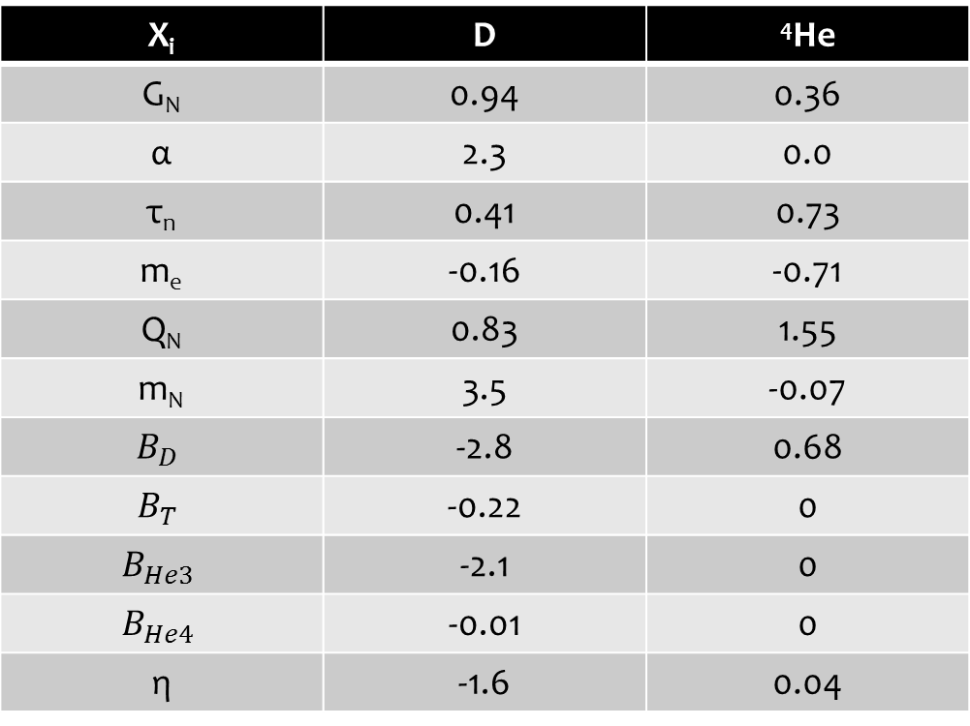
$$dlnY_{a}/dlnX_{i}$$
T. Dent, S. Stern & C. Wetterich Phys. Rev. D 76, 063513 (2007)
X_{i} | D | ⁴He
G_{N} | 0.94 | 0.36
α | 2.3 | 0.0
τ_{n} | 0.41 | 0.73
m_{e} | -0.16 | -0.71
Q_{N} | 0.83 | 1.55
m_{N} | 3.5 | -0.07
$$B_{D}$$ | -2.8 | 0.68
$$B_{T}$$ | -0.22 | 0
$$B_{He3}$$ | -2.1 | 0
$$B_{He4}$$ | -0.01 | 0
η | -1.6 | 0.04
Results were obtained using Kawano 1992 code (Report No. FERMILAB-PUB-92/04-A)

Slide 6
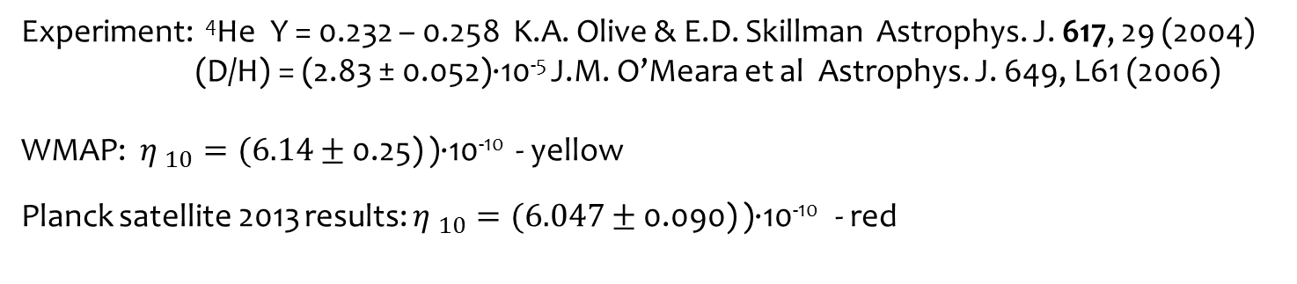
BBN predictions
Experiment: ⁴He Y = 0.232 – 0.258 K.A. Olive & E.D. Skillman Astrophys. J. 617, 29 (2004)
(D/H) = (2.83 ± 0.052)·10⁻⁵ J.M. O’Meara et al Astrophys. J. 649, L61 (2006)
WMAP: ${η }_{10}=(6.14±$ 0.25) )·10⁻¹⁰ - yellow
Planck satellite 2013 results: ${η }_{10}=(6.047±$ 0.090) )·10⁻¹⁰ - red

Slide 7



Boundaries on E_{D} variation
$$−9.4×{10}^{−2}<\frac{∆E_{D}}{E_{D}}<6.6×{10}^{−2}$$
$$−10.9×{10}^{−2}<\frac{∆E_{D}}{E_{D}}<3.6×{10}^{−2}$$
$$−9.4×{10}^{−2}<\frac{∆E_{D}}{E_{D}}<3.6×{10}^{−2}$$

Slide 8

E_{D} dependence from m$π$
Deuteron is a bound state of p-n system with quantum numbers: J^{π} = 1⁺
Deuteron is only barely bound: E_{D} = 2.22457 MeV
Nucleon-Nucleon on-shell momentum-space amplitude in general have the following form:
Where:

Slide 9
Calculation of effective N-N potential based on effective chiral perturbation theory
Starting point for the derivation of the N-N interaction is an effective chiral πN Lagrangian which is given by a series of terms of increasing chiral dimension:
Here

Slide 10
Main one- and two-pion contributions to NN interaction
N. Kaiser, R. Brockmann, W. Weise, Nucl. Phys. A 625 (1997) 758

Slide 11
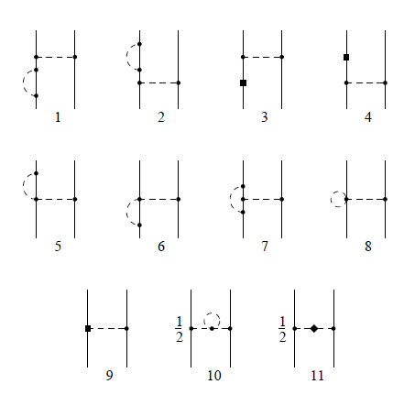
N-N interaction renormalization with m_{π}
The value of d₁₆ can be obtained from the fit to the process πN ππN:

Slide 12
Deuteron binding energy
The wave function of the bound state is obtained from the homogeneous equation:
As an input NN potential we use Idaho accurate nucleon-nucleon potential: D.R. Entem, R. Machleidt, Phys. Lett. B 524 (2002) p.93
It’s obtained within third order of chiral perturbation theory and describe rather well the phase shifts of NN scattering. It also describe precisely the deuteron properties:
 | Idaho | Empirical
Binding energy (MeV) | 2.224575 | 2.224575(9)
Asympt. S state (fm^{-1/2}) | 0.8846 | 0.8846(9)
Asympt. D/S state | 0.0256 | 0.0256(4)
Deuteron radius (fm) | 1.9756 | 1.9754(9)
Quadrupole momentum (fm²) | 0.284 | 0.2859(3)

Slide 13

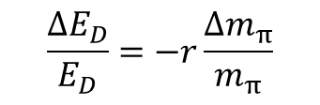
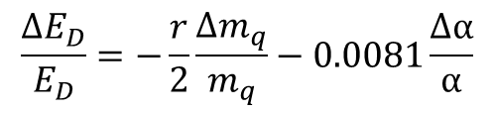



Results
$$\frac{∆E_{D}}{E_{D}}=−r\frac{∆m_{π}}{m_{π}}$$
$$r=5.4±0.4$$
$$−7×{10}^{−3}<\frac{∆m_{π}}{m_{π}}<1.9×{10}^{−2}$$
$${m_{π}}^{2}\sim (m_{u}+m_{d})Λ_{QCD}$$
$$\frac{∆E_{D}}{E_{D}}=−\frac{r}{2}\frac{∆m_{q}}{m_{q}}−0.0081\frac{∆α}{α}$$
$$−1.4×{10}^{−2}<\frac{∆m_{q}}{m_{q}}<3.8×{10}^{−2}$$

Slide 14
Thank you for your attention!

Slide 15
Comparing with previous results
V.V. Flambaum, E.V. Shuryak. Phys.Rev. D 65 (2002) 103503
E. Epelbaum, U.G. Meissner and W. Gloeckle, Nucl. Phys. A 714 (2003) 535
S.R. Beane & M.J. Savage. Nucl. Phys. A 717 (2003) 91

